Slide 1
Object Oriented Software Engineering (OOSE)
22CS017
Testing Object Oriented Applications
Lecture (Theory)
Prepared By Dr. Dinesh Vij

Slide 2
Index
Testing Object-Oriented Applications
Object Oriented Testing Strategies
Object Oriented Testing Methods
Testing OOA and OOD model

Slide 3
Testing Object-Oriented Applications
Object-oriented testing is a type of software testing that focuses on verifying the behaviour of individual objects or classes in an object-oriented system.
The goal of OO testing is to ensure that each object or class in the system performs its functions correctly and interacts appropriately with other objects or classes.

Slide 4
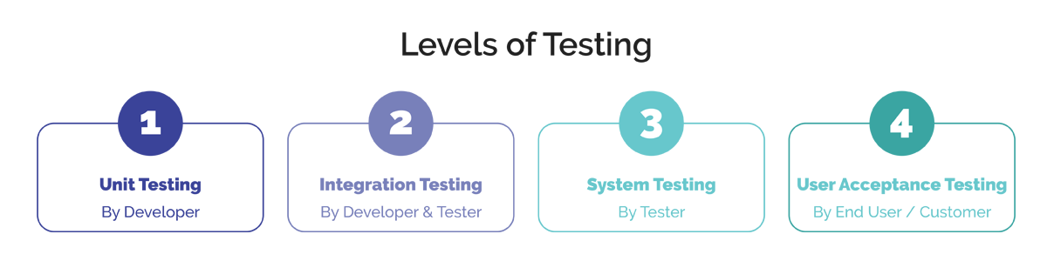
Testing Strategies
Fig 1: Levels of Testing

Slide 5
Testing Strategies
Unit Testing : It is a level of software testing where individual units/ components of a software are tested.
A unit is the smallest testable part of any software.
The purpose is to validate that each unit of the software performs as designed.
An encapsulated class is the focus of unit testing in object oriented context.
Class testing for object oriented software is analogous to module testing for conventional software. It is not advisable to test operations in isolation.

Slide 6
Unit Testing in the OO Context
When object-oriented software is considered, the concept of the unit changes.
Rather than testing an individual module, the smallest testable unit is the encapsulated class or object.
To illustrate, consider a class hierarchy in which an operation X is defined for the superclass and is inherited by a number of subclasses. Each subclass uses operation X, but it is applied within the context of the private attributes and operations that have been defined for the subclass. Because the context in which operation X is used varies in subtle ways, it is necessary to test operation X in the context of each of the subclasses. This means that testing operation X in the traditional unit testing approach is ineffective in the object-oriented context.

Slide 7
Unit Testing in the OO Context(cont.)
Because a class can contain a number of different operations and a particular operation may exist as part of a number of different classes, the meaning of unit testing changes dramatically.
Class testing for OO software is the equivalent of unit testing for conventional software. In class testing, every individual classes are tested for errors or bugs.
Class testing ensures that the attributes of class are implemented as per the design and specifications. It also checks whether the interfaces and methods are error free of not.

Slide 8
Unit Testing in the OO Context
Random testing and partitioning are methods that can be used to exercise a class during OO testing.
Random Testing for OO Classes:
▪ Identify operations applicable to a class
▪ Define constraints on their use
▪ Generate a variety of random test sequences.

Slide 9
Unit Testing in the OO Context
Partition Testing at the Class Level:
▪ State-based partitioning:
₋ It categorizes class operations based on their ability to change the state of the class.
₋ Test designed in such a way that operations that cause state changes are tested separately from those that do not.
▪ Attribute-based partitioning:
₋ For each class attribute, operations are classified according to those that use the attribute, those that modify the attribute and those that do not use or modify the attributes.
▪ Category-based partitioning:
₋ It categorizes class operations based on the generic function that each performs.
₋ For example, operations in the Account class can be categorized in initialization operations (open, setup), computational operations (deposit, withdraw), queries (balance, summarize), and termination operations (close).

Slide 10
Testing Strategies (contd.)
Integration Testing : It is a level of software testing where individual units are combined and tested as a group.
It is used to expose faults in the interaction between integrated units.
Also called as Interclass or subsystem testing.

Slide 11
Integration Testing in the OO Context
As object-oriented software does not have a hierarchical control structure, conventional top-down and bottom-up integration strategies have little meaning.
In addition, integrating operations one at a time into a class (the conventional incremental integration approach) is often impossible because of the “direct and indirect interactions of the components that make up the class”.
Different strategies for integration testing of OO systems:
Thread-based testing
Use-based testing
Cluster testing

Slide 12
Integration Testing in the OO Context
Thread-based testing: It integrates the set of classes required to respond to one input or event for the system.
Each thread is integrated and tested individually.
Regression testing is applied to ensure that no side effects occur.
Use-based testing: The integration approach begins the construction of the system by testing the independent classes.
After the independent classes are tested, the next layer of classes, called dependent classes, that use the independent classes are tested.
This sequence of testing layers of dependent classes continues until the entire system is constructed.
Cluster testing : Here, a cluster of collaborating classes is exercised by designing test cases that attempt to uncover errors in the collaborations.

Slide 13
Testing Strategies (contd.)
Validation Testing : It is described as the last chance to catch program errors before delivery to the customer.
Alpha/Beta testing: This strategy focuses on customer usage.
Alpha tests are conducted in a controlled environment and conducted at the developer’s site by end-users.
The s/w is used in natural setting with the developer with users, recording errors and usage problems.
The beta-test is conducted at the end-users sites where developer is generally not present.
Beta test is a live application of the software in an environment that cannot be controlled by the developer.
The end-user records errors and all usage problems encountered during the test and the list is reported to the developer.
And then modifications are done to prepare for release of product to the entire customer base.

Slide 14
Testing Strategies (contd.)
System Testing : The focus is on testing the system as a whole. Following are the types of system tests:
Recovery Testing : Forces the software to fail in a variety of ways and verifies that recovery is properly performed.
Security Testing : It verifies that protection mechanisms built into a system will, in fact, protect it from improper penetration.
Stress Testing : It executes a system in a manner that demands resources in abnormal quantity, frequency, or volume. For example:
Special tests may be designed to generate 10 interrupts per second, when 1 or 2 is the average rate.
Test cases causing memory management problems are designed.
Test cases that may cause excessive hunting for disk-resident data are created.
Performance Testing : It tests the run-time performance of software within the context of an integrated system.
Performance tests are generally coupled with stress testing.

Slide 15
Test Case Design for OO Software
An approach to OO test case design can been defined as :
Each test case should be uniquely identified and explicitly associated with the class to be tested.
The purpose of the test should be stated.
Test case design becomes more complicated as integration of the OO system begins. It is at this stage that testing of collaborations between classes must begin.
Steps should be developed for each test and should contain:
A list of specified states for the object that is to be tested.
A list of messages and operations that will be exercised as a consequence of the test.
A list of exceptions that may occur as the object is tested.

Slide 16
Purpose of Object-Oriented Testing
Object Interaction Validation: This Check is to make sure objects interact with one another appropriately in various situations. Testing makes ensuring that the interactions between objects in object-oriented systems result in the desired results.
Determining Design Errors: This is to find the object-oriented design’s limitations and design faults. Testing ensures that the design complies with the desired architecture by assisting in the identification of problems with inheritance, polymorphism, encapsulation and other OOP concepts.
Finding Integration Problems: This is to evaluate an object’s ability to integrate and communicate with other objects when it is part of a bigger component or subsystem. This helps in locating integration difficulties, i.e. improper method calls or issues with data exchange.

Slide 17
Purpose of Object-Oriented Testing
Assessment of Reusable Code: This is to evaluate object-oriented code’s reusability. Code reuse is promoted by object-oriented programming via features like inheritance and composition. Testing ensures that reusable parts perform as intended in various scenarios.
Verification of Handling Exceptions: Confirm that objects respond correctly to error circumstances and exceptions. The purpose is to make sure that the software responds carefully and is durable in the face of unforeseen occurrences or faults.
Verification of Uniformity: Maintain uniformity inside and between objects and the object-oriented system as a whole. Maintainability and readability are enhanced by consistency in naming standards, coding styles and compliance to design patterns.

Slide 18
Object-Oriented Applications and Design
Object-Oriented Analysis and Design (OOAD):
It is a software engineering methodology that involves object-oriented concepts to design and implement software systems.
It involves a number of techniques and practices, including object-oriented programming, design patterns, UML diagrams, and use cases.
Some important aspects of OOAD:
Object-Oriented Programming: It involves modeling real-world objects as software objects, with properties and methods that represent the behavior of those objects. OOAD uses this approach to design and implement software systems.
Design Patterns : There are reusable solutions to common problems in software design. OOAD uses design patterns to help developers create more maintainable and efficient software systems.

Slide 19
Object-Oriented Applications and Design
Some important aspects of OOAD:
3. Unified Modeling Language (UML) Diagrams: It is a standardized notation for creating diagrams that represent different aspects of a software system.
UML diagrams are used to represent the different components and interactions of a software system.
4. Use Cases: Use cases are a way of describing the different ways in which users interact with a software system.
Use cases are used to help developers understand the requirements of a system and to design software systems that meet those requirements.

Slide 20
Advantages of OOAD
Reusability: OOAD emphasizes the use of reusable components and design patterns, which can save time and effort in software development.
Scalability: OOAD can help developers design software systems that are scalable and can handle changes in user demand and business requirements over time.
Maintainability: OOAD emphasizes modular design and can help developers create software systems that are easier to maintain and update over time.
Flexibility: OOAD can help developers design software systems that are flexible and can adapt to changing business requirements over time.

Slide 21
Disadvantages of OOAD
Complexity: This can be complex and may require significant expertise to implement effectively.
Time-consuming: can be a time-consuming process that involves significant upfront planning and documentation.
Rigidity: Once a software system has been designed using OOAD, it can be difficult to make changes without significant time and expense.
Cost: can be more expensive than other software engineering methodologies due to the upfront planning and documentation required.

Slide 22
Approach of OOAD
Overall, OOAD can be an effective approach to designing and implementing software systems, particularly for complex or large-scale projects. However, it’s important to weigh the advantages and disadvantages carefully before adopting this approach.

Slide 23
Object-Oriented Analysis
Object-Oriented Analysis (OOA)
It is the first technical activity performed as part of object-oriented software engineering. OOA introduces new concepts to investigate a problem.
It is based on a set of basic principles, which are as follows-
The information domain is modeled in OOA.
Here, Behavior is represented.
The function is described in OOA.
Here, Data, functional, and behavioral models are divided to uncover greater detail.
Early models represent the essence of the problem, while later ones provide implementation details.

Slide 24
Object-Oriented Design
Object-Oriented Design (OOD):
An analysis model created using object-oriented analysis is transformed by object-oriented design into a design model that works as a plan for software creation.
OOD results in a design having several different levels of modularity i.e., The major system components are partitioned into subsystems (a system-level “modular”), and data manipulation operations are encapsulated into objects (a modular form that is the building block of an OO system.).
In addition, OOD must specify some data organization of attributes and a procedural description of each operation.
It shows a design pyramid for object-oriented systems. It is having the following four layers.

Slide 25
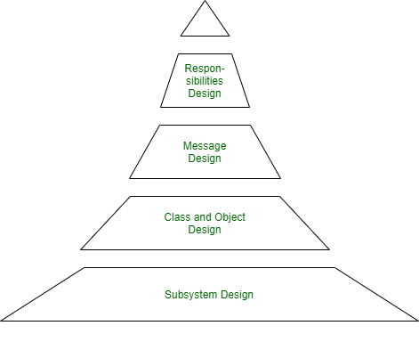
Object-Oriented Design
Figure 2: Object-Oriented Design (OOD) Pyramid

Slide 26
Object-Oriented Design
The Subsystem Layer : It represents the subsystem that enables software to achieve user requirements and implement technical frameworks that meet user needs.
The Class and Object Layer: It represents the class hierarchies that enable the system to develop using generalization and specialization. This layer also represents each object.
The Message Layer: It represents the design details that enable each object to communicate with its partners. It establishes internal and external interfaces for the system.
The Responsibilities Layer: It represents the data structure and algorithmic design for all the attributes and operations for each object.

Slide 27
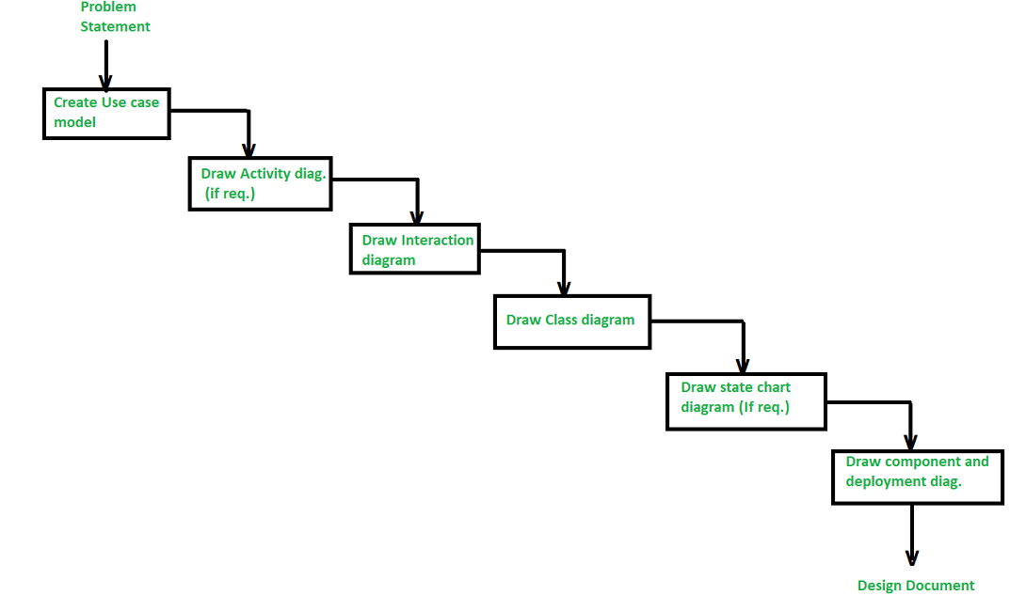
Steps to Analyze and Design Object Oriented
System
Figure 3: Steps/Stages in the analysis and design of an object-oriented system

Slide 28
Steps to Analyze and Design Object Oriented
System
There are various steps/stages in the analysis and design of an object-oriented system as given in below figure :
Create a Use case model :
The first step in the analysis and design of an object-oriented system is to recognize the actors interlinked with the system. After that, create the use case and draw the use case diagram.
2. Draw activity diagram (If required) :
The activity diagram demonstrates the dynamic nature of a system by creating the flow of control form activity. An activity addresses a procedure on some class in the framework that outcomes in an adjustment of the condition of the system. The below figure shows the activity graph handling a request to convey a few products.

Slide 29
Steps to Analyze and Design Object Oriented
System (cont.)
3. Draw the interaction diagram :
An interaction diagram shows a collaboration comprising a bunch of articles and their relationship, including the messages that might be dispatched among them. Interaction diagram address the unique perspective on a system.
Steps for drawing interaction diagrams :
Initially, we ought to distinguish that the objects as for each use case.
Then we draw the sequence diagrams for each use case.
Then we draw the collaboration diagrams for each use case.

Slide 30
Steps to Analyze and Design Object Oriented
System
4. Draw the class diagram : The class diagram is responsible for showing the relationship between the classes. There are four types of relationships available:
Association– It is a semantic connection between classes. At the point when an association associates two classes, each class can send messages to the next in sequence or a collaboration diagram. They may be bi-directional or unidirectional in nature.
Dependencies–
They connect two classes and are always unidirectional in nature and display that one class, depends on the definitions of another class.
Aggregations–
They are a stronger form of association that shows the relationship between a whole and its parts.
Generalizations–
They are used to display an inheritance relationship between the two classes.

Slide 31
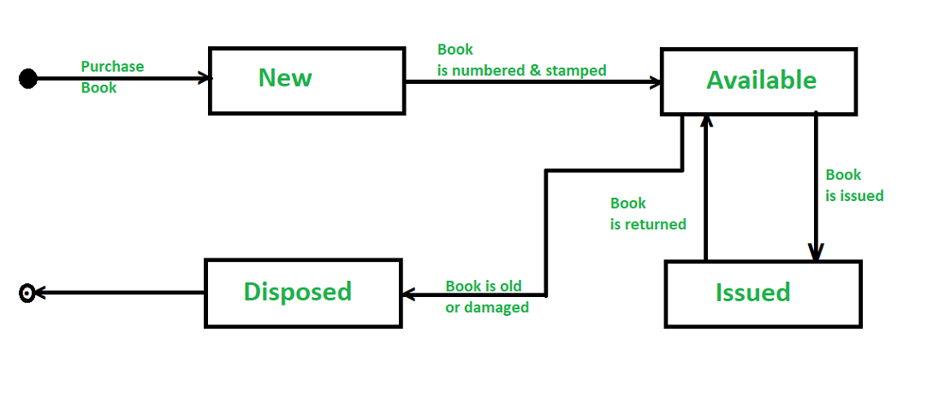
Steps to Analyze and Design Object Oriented
System
5. Design of State chart diagrams :
A state chart is utilized to show the state space of a given class, the occasion that influences progress starting with one state then onto the next, and the activity that outcome from a state change. A state change graph for a “book” in the library management system is shown below :
Figure 4: State Change Graph Example
6. Draw component and development diagram :
These diagrams address the static execution perspective on a system that are identified with class diagrams in that a segment ordinarily guides to at least one class, interface, or coordinated effort.

Slide 32
Testing Techniques
Fault Based Testing:
This checking permits for coming up with test cases supported the consumer specification or the code or both. It tries to identify possible faults (areas of design or code that may lead to errors.).
For all of these faults, a test case is developed to “flush” the errors out.
These tests also force each time of code to be executed.
This method of testing does not find all types of errors.

Slide 33
Testing Techniques
Fault Based Testing (cont.):
However, incorrect specification and interface errors can be missed. These types of errors can be uncovered by function testing in the traditional testing model.
In the object-oriented model, interaction errors can be uncovered by scenario-based testing.
This form of Object-oriented testing can only test against the client’s specifications, so interface errors are still missed.

Slide 34
Testing Techniques
Fault Based Testing Techniques(2 Types)
Mutation Testing
Mutation testing involves the deliberate introduction of artificial faults (mutations) into the source code. These mutations represent common programming mistakes, such as changing an operator or variable. Test cases are then executed against the mutated code to assess whether they can detect and reveal the introduced faults. The effectiveness of the test suite is measured by its mutation score, indicating how many mutations were successfully detected.
Fuzz Testing
Fuzz testing, or fuzzing, focuses on feeding the software with a variety of malformed, or unexpected inputs. This technique is particularly useful for uncovering vulnerabilities and security flaws in a system. Fuzzers automatically generate and send inputs to the software, monitoring its behavior for crashes or unexpected responses. By doing so, fuzz testing helps identify issues in input validation, boundary checking, and exception handling.

Slide 35
Testing Techniques
Scenario-based Testing:
Scenario Testing is a software testing technique that uses scenarios to help the tester work through a complicated problem or test system.
A test scenario or user scenario is a story which describes the usage of the software by an end user.
It is performed to ensure that the end to end functioning of software and all the process flows of the software are working properly.
In scenario testing:
The testers assume themselves to be the end users and find the real world scenarios or use cases which can be carried out on the software by the end user.
For this, the testers take help from clients, stakeholders and developers to create test scenarios. In the object-oriented model, interaction errors can be uncovered by scenario-based testing.

Slide 36
Practice Questions
Q1. The construction of object-oriented software begins with the creation of a) design model b) analysis model c) code levels d) both design and analysis model Answer: d
Q2. Which testing integrates the set of classes required to respond to one input or event for the system?
cluster testing
thread-based testing
c) use-based testing
d) none of the mentioned
Answer: b
Q3. In which of the following testing strategies, a smallest testable unit is the encapsulated class or object? a) Unit testing b) Integration testing c) System testing d) None of the mentioned
Answer: a

Slide 37
Bibliography
https://www.javatpoint.com/difference-between-object-oriented-testing-and-conventional-testing
https://www.tutorialspoint.com/object_oriented_analysis_design/ooad_testing_quality_assurance.htm
https://www.softwaretestinghelp.com/types-of-software-testing/
https://www.techtarget.com/searchsoftwarequality/definition/integration-testing

Slide 38
THANK YOU

